Slide 1
The Roman Empire and Han Dynasty China:
A Comparison
Notes:
Introduction
The several centuries of success for Han China (202 BCE – 220 CE) and the Roman Empire (27 BCE – 476 CE) pinpoint possibilities for comparison in the classical period. They can also help and American audience combine more familiar knowledge, usually about Rome, with an appreciation for less familiar classical achievements, as in China. Both empires provided relative peace over wide areas, organized vigorous internal trading networks, and created immensely potent political systems. Elements of their achievements – Roman law, for example, or the Chinese principles of bureaucracy – would shape world history even to the present day. But the empires were also different, for example, in military and expansionist outlook and in cultural integration. These difference would affect the ultimate legacy of each empire.

Slide 2
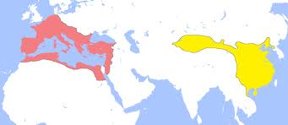
Imperial Rome and Han China
Both lasted approximately 400 years
Both had populations of about 50 million

Slide 3
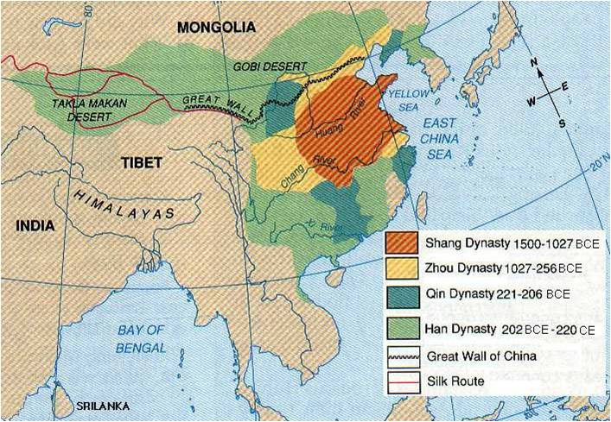
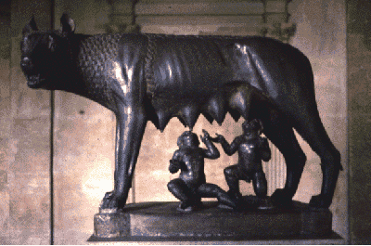
Origins of empire
Han China built on earlier imperial traditions started by the Qin and Zhou
Rome built on aristocratic landlords expanding out from a city-state
Notes:
The two empires obviously had different origins
The Han dynasty sprung more directly from earlier dynastic activity in classical China, replacing a period of disorder under the Zhou dynasty (which supplanted the Qin dynasty following the Warring States Period) with a focus on the importance of political order.
Rome’s origins in politics had more to do with the control of the aristocratic landlords and the importance of a certain “democratic” or oligarchic element during the years of the Republic, both of which were overridden by the institution of the Empire.

Slide 4
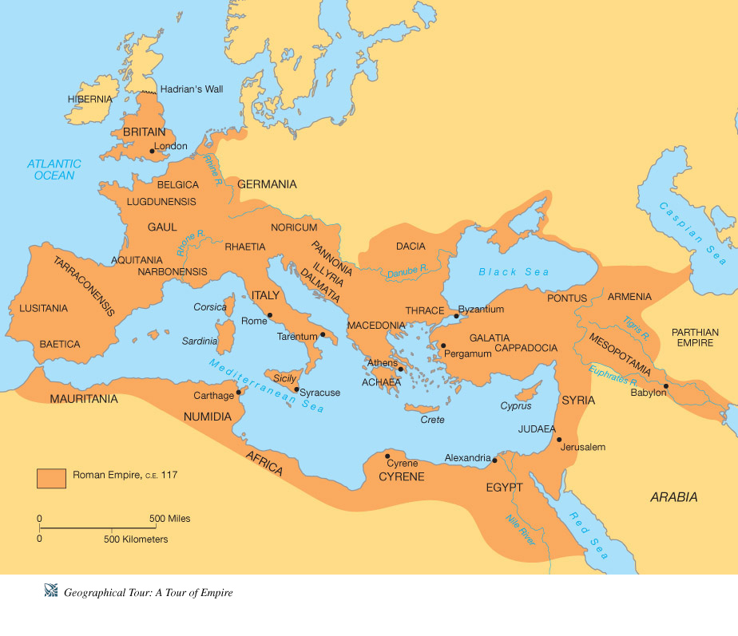
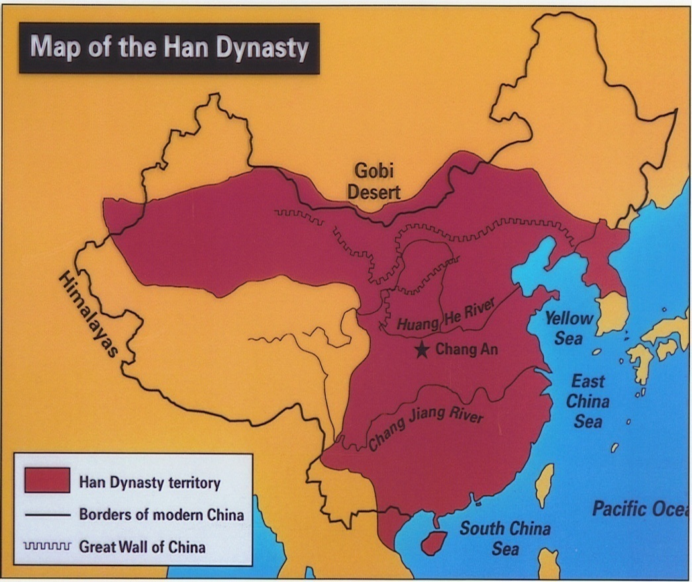
Militarism: Both emphasized territorial expansion
Roman Empire
Han China
Perceived threats to security led to wars and conquests, which only increased the length of borders and led to more perceived threats…which led to more conquests. A pattern.

Slide 5
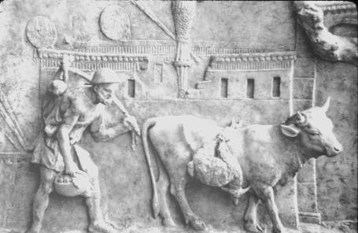
Economic Base
Agriculture was the base
Land = wealth
Gov’t revenue based on a % of the annual harvest

Slide 6
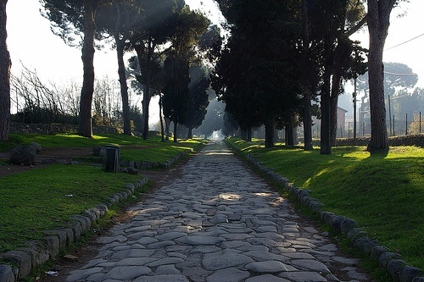
Integrating the empires
Infrastructure:
Massive road building projects linked crucial parts of the empires
Roads facilitated communication, economic activity, access to resources, and movement of military.
Rome – invented concrete & engineered feats like aqueducts
Yep – that’s a Roman Road, still around today. Looking good after 2,000 years.

Slide 7
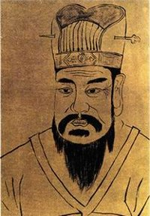
Mechanisms for political integration in China
Confucianism identified principles necessary for political and social order
Emphasized the emperors’ divine majesty, links to Heaven, and morality through correct ritual (ancestor veneration
Developed a sophisticated bureaucracy with gov’t officials in the provinces (staffed by middle class)
Imperial Academy and exam system meant ALL areas of China were cohesive & Confucian
Notes:
Both empires worked directly for political integration using slightly different mechanisms.
In Han China, several devices combined to produce a political structure capable of ruling a vast empire.
The Han dynasty attempted to further Confucian thought as a means of inculcating certain values in the elite, and if possible, other classes. The emperors continued a tradition of emphasizing their divine or semi-divine majesty. Finally, the Han introduced the first clear system of bureaucracy, in which the central government designated representatives in the provinces.

Slide 8
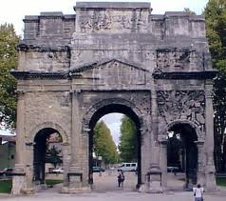
Mechanisms for political integration in the Roman Empire
Bureaucracy was less complex than Han – relied on local elites & middle class to control provinces
Greater emphasis on law codes and a common legal system
Monuments and triumphal processions played up the glory of the empire and its rulers
Cult of deceased Emperors
Notes:
Rome had its own methods of attaining political integration.
Many Roman writers, particularly early in the empire, were eager to sing the praises of the emperors and the imperial system.
Rome developed a somewhat more rudimentary bureaucracy than the Chinese, but the Romans placed more emphasis on the legal system and the rule of law across the empire.
Rome did not usually assert the divinity of the emperors themselves, but surpassed the Han in imperial monuments, triumphal processions, and emphasis placed on the majesty of the emperor.

Slide 9
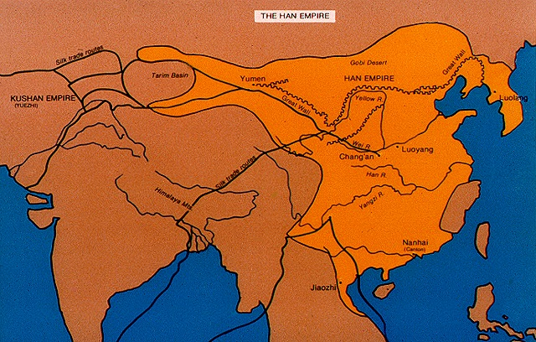
Citizenship and Colonies
Large colonies of ethnically Han (northern) Chinese were planted in newly conquered territories
Use of Mandarin language required by the elite and bureaucrats
Ideology of Confucianism enforced by the central authority
Notes:
The differences in these two systems of empire still seem to fall within a context of similarities.
The Chinese regime worked harder at integrating its vast territory than the Romans.
The Middle Kingdom in China in the classical period was the scene of major ethnic mixing and division, particularly in South China. The regime tackled this head-on by planting large numbers of people from the heart of the empire in the north to the south. Additionally, Mandarin was required by the elite and all levels of bureaucracy. Other classes were strongly encouraged to adopt Mandarin.

Slide 10
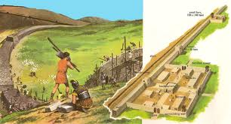
Rome also used colonies to foster unity and integration throughout the Empire
Colonies were basically military outposts not intended for population integration
Latin was encouraged but never took over Greek in the East (people STILL looked up to Greek culture)
Expansion of Roman citizenship given for army service
Loose control and more local autonomy
Notes:
Rome planted colonies in the hinterlands of their empire, but they were colonies of soldiers, and the hope was that they would begin to foster the Roman lifestyle among the conquered people of the remote provinces. These were smaller colonies and not intended for population integration.
The Romans encouraged the use of Latin by the upper classes, although it never managed to erase the predominance of Greek in upper-class circles in the eastern Mediterranean. The Romans emphasized the expansion of Roman citizenship to those willing to serve in the Roman Army. Despite these integrating devices, Rome was content to establish looser control over most of its provinces and to rely on local autonomy.

Slide 11
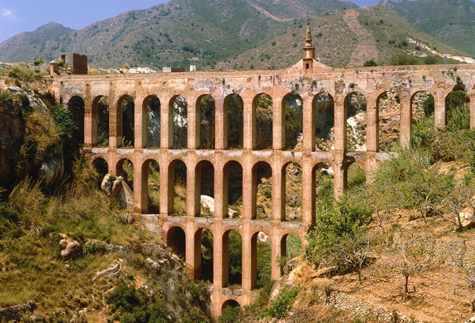
The power of the central governments in Han China and Imperial Rome
Both systems expanded the functions of government
Used bureaucracy and taxation to provision major cities & increased coercion with military
Both governments were actively engaged in a economic activity designed to ensure a stable social and political order
For example, the Han gov’t held monopoly power on the trade of salt and iron

Slide 12
Territorial expansion
Imperial Rome
Han China
Pushed boundaries far beyond Qin homeland, but when they reached a sustainable point, did not feel the need to compensate for cessation of expansion
Labor force not reliant on slavery – peasant population made constant expansion less necessary
A more militaristic culture
Romans needed additional territory to pay soldiers
They needed a continuing supply of slaves for their labor system

Slide 13
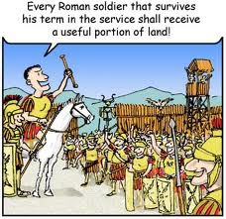

Slide 14
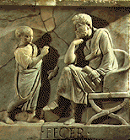
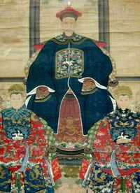
Family and Society
Both dominated by patriarchy & reverence for fathers
Both focused on veneration of ancestors (but more so the Han)
Han – family was the model of organization for the state

Slide 15
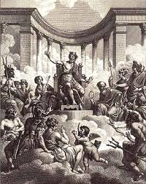
religious and philosophical systems
Early on, both empires focused on rituals and themes that would bring loyalty to the empire, but neither was intensely spiritual
Both were exposed to new religions late in the Classical Period (Buddhism in China, Christianity in Rome)

Slide 16
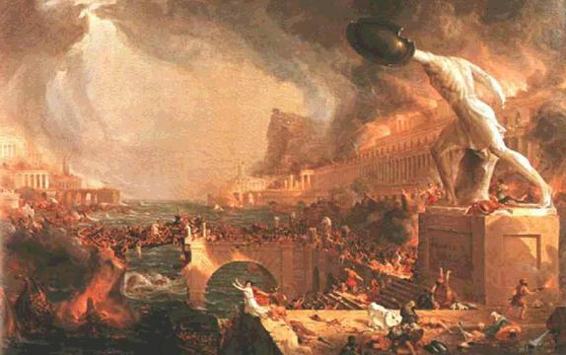
Decline of Imperial Rome and Han China
Overexpansion led to invasions by nomadic pastoralists
Tax based weakened as land (wealth) was concentrated into fewer hands who paid less in taxes
Western Roman cultural elements died out with the empire: change
Han dynasty was destroyed, but its institutions and traditions were revived by later dynasties: continuity

Slide 17
Why Was China Revived and Rome Not?
There was no Roman equivalent of Confucianism—no method or idea of political organization and social conduct that could survive the breakdown of the Roman state
Dynasties come and go in China, but Confucianism lasts forever. ☺

